Slide 1
Summer Internship Report
RCS Based Chat System
By Tushar Gautam

Slide 2
About RCS Messaging
Millions of businesses rely on SMS to communicate with mobile consumers. Credit card fraud alerts, flight status updates, and package delivery notifications are common examples of business-to-consumer SMS.
RCS (Rich Communication Services) upgrades SMS with branding, rich media, interactivity and analytics. With RCS, businesses can bring branded, interactive mobile experiences, right to the default messaging app.
RCS provides Faster and simpler way of communication by providing App like functions without need of any apps gives business market new way of reaching consumers using messaging, file transfer, chatbots, etc features.

Slide 3
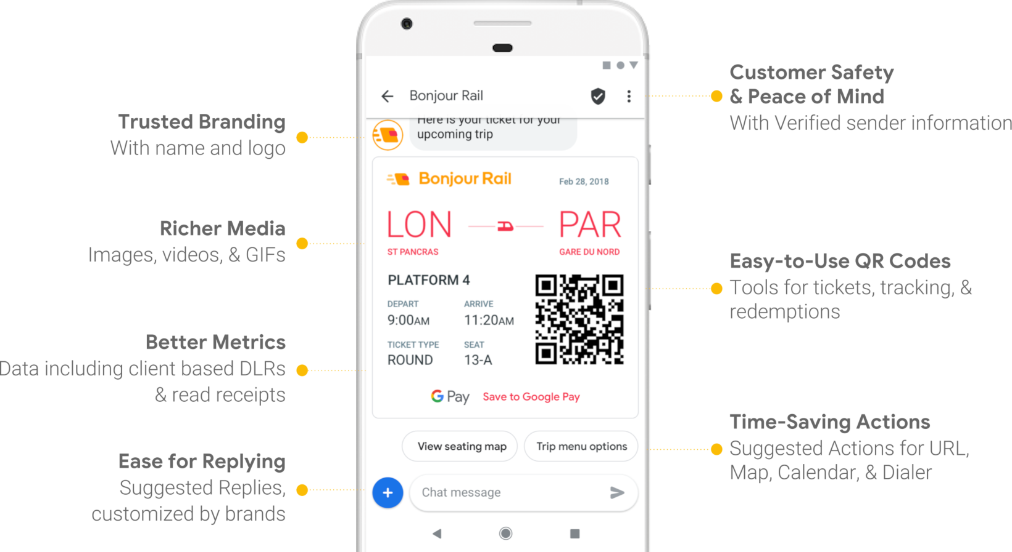

Slide 4
Project
RCS Based One to One Chat System.
Messaging over networks with unique contact ids (such as email id, tel no.) without worrying about network IPs.
Using “OpenSips” to act as SIP server for registration/initiation.
“Python Sockets” act as user agents. Can be used by the users to chat, share files, etc
Connection is first set up by user-clients registering to SIP server, then for one user-client to contact other user-client it can send an INVITE other user-client to the SIP server after which initiation takes place.
.

Slide 5
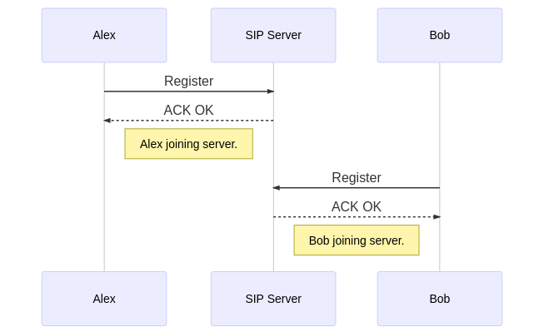
Registration

Slide 6
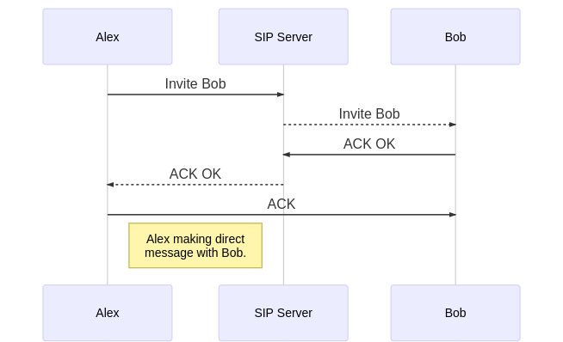
Invite

Slide 7
Conclusion
With increasing demand of better speed need for 5G and better communication services arises.
RCS act as an alternative to replace traditional SMS and also grants a way for Businesses to provide an app replacing feature rich mobile messaging using chatbots and AI.
RCS based one to one chat is a simple learning experience for getting introduced to various protocols involved in RCS model and also in understanding the working of mobile communication networks.

